Slide 1

Proposed DPhil project (2013 - 17)
Neurobiological and computational mechanisms of complex planning and uncertainty in navigation
Student
Juan del Ojo Balaguer
Supervisor
Dr Christopher Summerfield

Slide 2
Background
Decisions involve learning about the value of actions.
Reinforcement learning (RL) describes how action values are updated on the basis of prediction errors.
Neurobiology provides evidence that the brain implements RL.
1 (6)

Slide 3
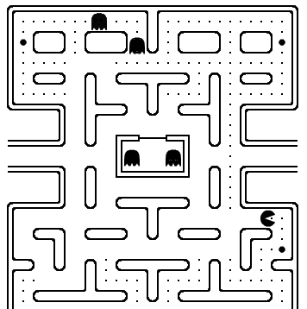
Background
Standard ('model-free') RL has an important limitation.
When several steps are required to harvest a reward, decisions can be improved by planning.
1 (6)

Slide 4
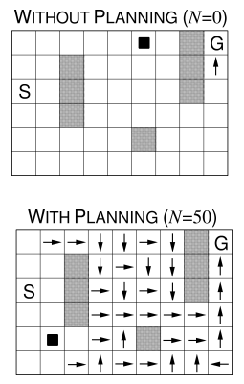
Background
Model-based RL describes how we can plan based on a model of the environment.
Planning allows us to update action values by exploring our model of the world, via mental simulation.
1 (6)

Slide 5
Models
Humans are limited-capacity agents.
We deal with the accuracy/complexity trade-off using heuristic strategies.
An ideal observer will estimate uncertainty when choosing between plans. But estimating uncertainty is costly.
2 (6)

Slide 6
Research questions
1 \ Are human subjects optimal when making plans to solve multi-step decision problems?
2 \ How do humans deal with exploration / exploitation trade-off in multistep decision problems?
3 \ What are the neural substrates underlying those strategies?
3 (6)

Slide 7
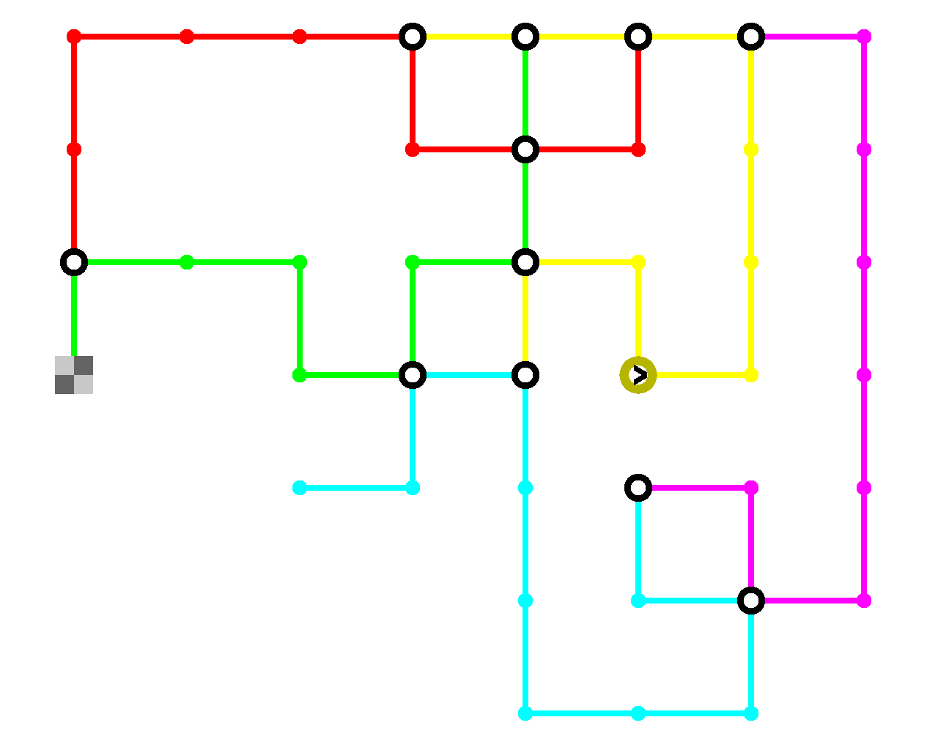
Experiment 1
1 \ Task: planning journeys through a virtual subway network
4 (6)
goal
destination
start

Slide 8
Experiment 1
2 \ Vary parameters such as mean and variance of speed of each line
4 (6)
fast
slow

Slide 9
Pilot data
– 10 subjects
– 10 trials/map
– goal: minimize travel time
– Fixed mean of the speed of each line, with some variability
4 (6)

Slide 10
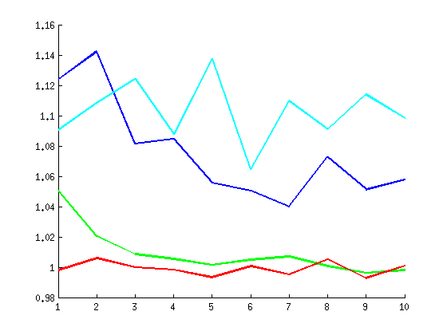
Comparison of human and model data
distance model
human subjects
total time
(relative to the omniscient model)
statistical model
omniscient model
trials (journeys)
5 (6)

Slide 11
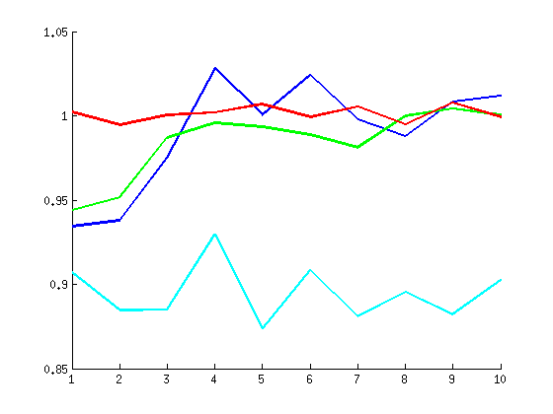
Humans increase speed across trials
human subjects
omniscient model
speed of lines chosen
(relative to the omniscient model)
statistical model
distance model
trials (journeys)
5 (6)

Slide 12
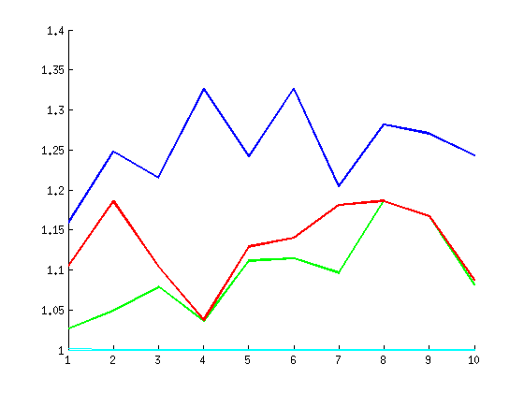
Humans maintain distance across trials
human subjects
omniscient model
distance
(relative to the distance model)
statistical model
distance model
trials (journeys)
5 (6)

Slide 13
Future plans and conclusions
1 \ Are human subjects optimal during navigation planning?
2 \ How humans deal with exploration/exploitation trade-off in multi-step decision problems?
3 \ What are the neural substrates underlying those strategies?
Pilot of Experiment 1:
Proof of concept
Experiment 2:
Same task with both different mean and variance
Computational models
...taking risk into account
Experiment 3:
Use the computational models to predict brain activity in the fMRI scanner
6 (6)

